Slide 1
Lecture 5: Data Encryption Standard
An Introduction to Information Security
School of Big Data and Software Engineering, CQU
Fall, 2018

Slide 2
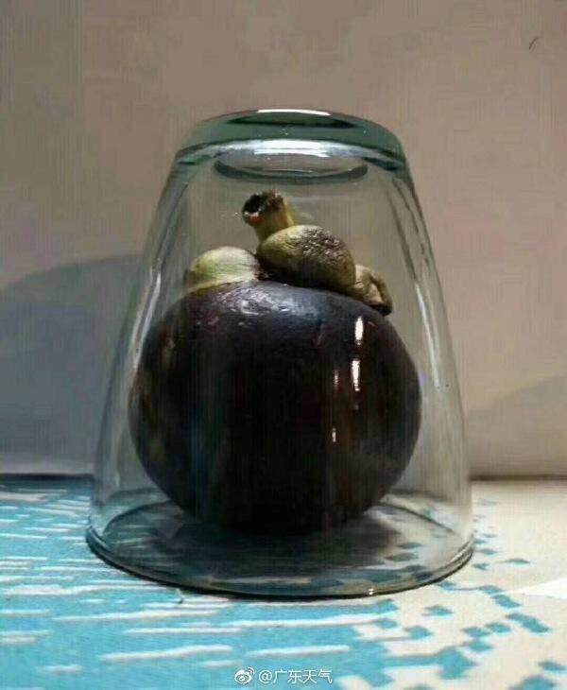
Pic

Slide 3
Quickly Review
Lecture 4
Product Cipher
The Feistel Cipher
Block Cipher Design Principals

Slide 4
“拧麻花”
L15
R15
+
F
k16
Round 16
L16
R16
output
L17
R17
+
F
k16
Round 16⁻¹
L15
R15

Slide 5
“拧麻花”
L15
R15
+
F
k16
Round 16
L16
R16
output
L17
R17
+
F
k16
Round 16⁻¹
L15
R15

Slide 6
“拧麻花”
R15
Round 16
L16
output
R17
Round 16⁻¹
L15

Slide 7
“拧麻花”
L15
R15
+
F
k16
Round 16
output
+
F
k16
Round 16⁻¹
R15

Slide 8

Outline
1. Data Encryption Standard-DES
2. Security of DES
3. Multiple Encryption and 3-DES

Slide 9
Lecture 5: Data Encryption Standard
1. Data Encryption Standard
2…
3…
1.1 DES Encryption
Data Encryption Standard
1.2 DES Decryption
1.3 Key Generation and expansion

Slide 10
Lecture 5: Data Encryption Standard
1. Data Encryption Standard
2…
3…
DES: Overview
most widely used block cipher in the world
adopted in 1977 by NBS (now NIST)
as FIPS (Federal Information Processing Standard ) PUB 46
Feistel cipher structure
encrypts 64-bit data block using 56-bit key
16 rounds
has (had) widespread commercial use(商业用途)
has been considerable controversy(争辩) over its security
…

Slide 11
Lecture 5: Data Encryption Standard
1. Data Encryption Standard
2…
3…
DES: History
IBM: Feistel Team
1960’s
1971
LUCIFER
NBS Request DES
1973
Adopted
Now:3DES
1977

Slide 12
Lecture 5: Data Encryption Standard
1. Data Encryption Standard
2…
3…
2.1 DES Encryption: Whole Picture
The encryption process is made of 2 permutations (P-boxes), which we call initial(初始) and final permutations, and 16 Feistel rounds.
Initial permutation
DES
64bit plaintext
K₁
56bit key
Round 1
K₂
Round 2
Round-key generator
. .
.
. .
.
K₁₆
Round 16
64bit ciphertext
Final permutation

Slide 13
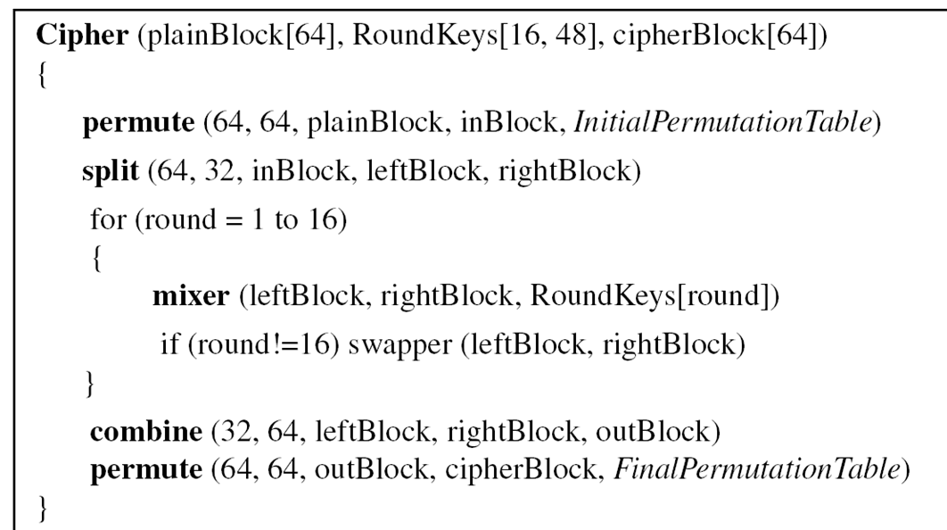
Lecture 5: Data Encryption Standard
1. Data Encryption Standard
2…
3…
2.1 DES Encryption: Pseudocode (伪代码)

Slide 14
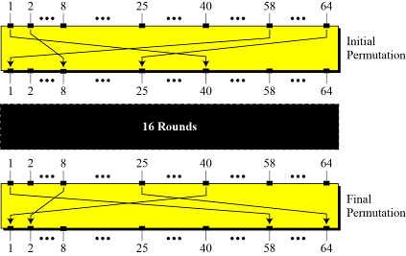
Lecture 5: Data Encryption Standard
1. Data Encryption Standard
2…
3…
2.1 DES Encryption: Initial and Final Permutations
Initial Permutations: IP
Final Permutations: IP⁻¹
The initial and final permutations are straight P-boxes that are inverses(互逆的) of each other.
They have no much cryptographic significance(意义) in DES.

Slide 15
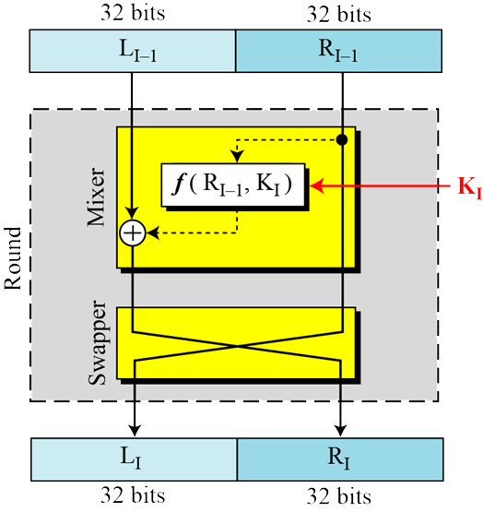
Lecture 5: Data Encryption Standard
1. Data Encryption Standard
2…
3…
2.1 DES Encryption: Rounds
DES uses 16 rounds. Each round of DES is a Feistel cipher.
L_{i} = R_{i-1}
R_{i} = L_{i-1} f(R_{i-1}, K_{i})
+
A round in DES (encryption site)

Slide 16
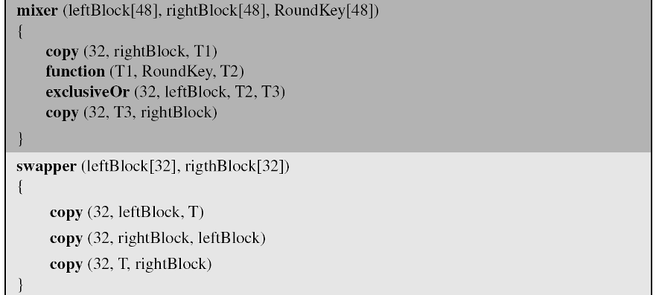
Lecture 5: Data Encryption Standard
1. Data Encryption Standard
2…
3…
2.1 DES Encryption: Pseudocode for a Round

Slide 17
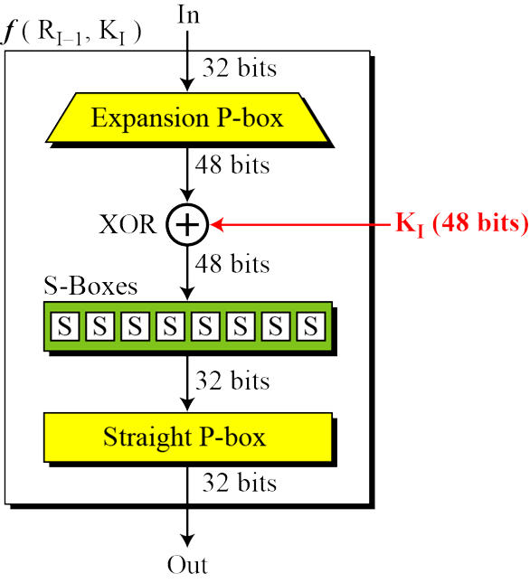
Lecture 5: Data Encryption Standard
1. Data Encryption Standard
2…
3…
2.1 DES Encryption: Feistel Function (DES Function)
The heart of DES is the DES function.
The DES function applies a 48-bit round- key to the rightmost 32 bits to produce a 32-bit output.
DES function

Slide 18
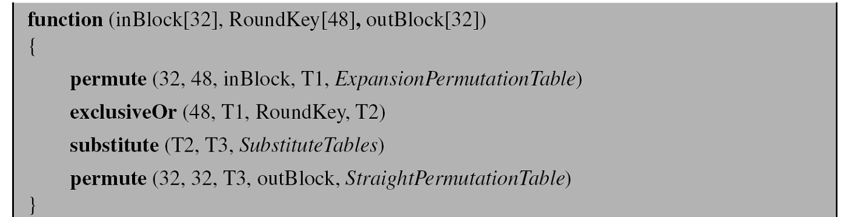
Lecture 5: Data Encryption Standard
1. Data Encryption Standard
2…
3…
2.1 DES Encryption: Pseudocode for DES Function

Slide 19
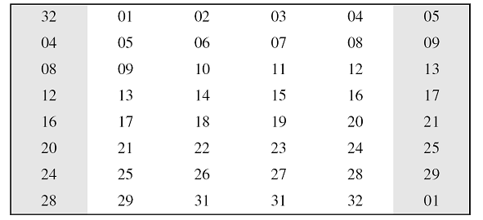
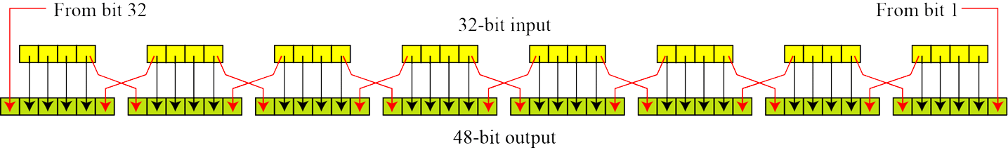
Lecture 5: Data Encryption Standard
1. Data Encryption Standard
2…
3…
2.1 DES Encryption: Feistel Function (DES Function)
E-Pbox
Since R_{i−1} is a 32-bit input and K_{i} is a 48-bit key, we first need to expand R_{i−1} to 48 bits.

Slide 20
Lecture 5: Data Encryption Standard
1. Data Encryption Standard
2…
3…
2.1 DES Encryption: Feistel Function (DES Function)
XOR： “Add” Round Key
After the expansion permutation, DES uses the XOR operation on the expanded right section and the round key. Note that both the right section and the key are 48-bits in length. Also note that the round key is used only in this operation.

Slide 21
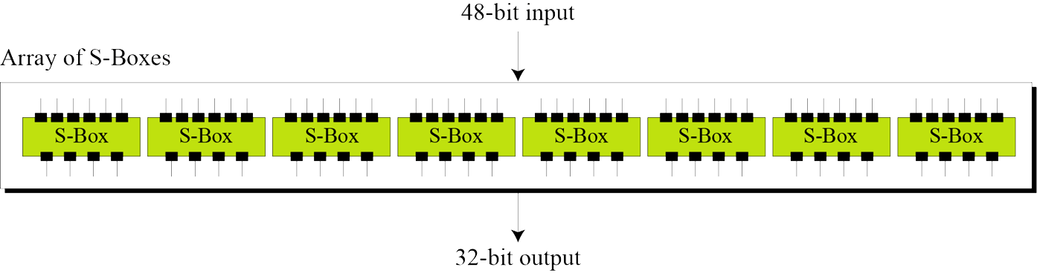
Lecture 5: Data Encryption Standard
1. Data Encryption Standard
2…
3…
2.1 DES Encryption: Feistel Function (DES Function)
S-box
The S-boxes do the real mixing (confusion). DES uses 8 S-boxes, each with a 6-bit input and a 4-bit output.

Slide 22
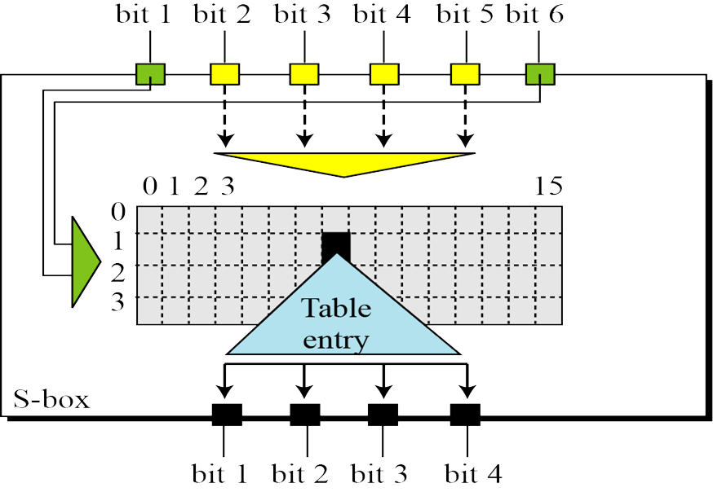
Lecture 5: Data Encryption Standard
1. Data Encryption Standard
2…
3…
2.1 DES Encryption: Feistel Function (DES Function)
S-box
The S-boxes do the real mixing (confusion). DES uses 8 S-boxes, each with a 6-bit input and a 4-bit output.

Slide 23
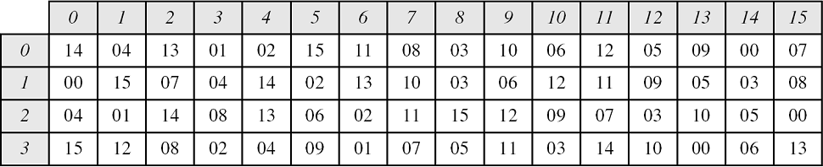
Lecture 5: Data Encryption Standard
1. Data Encryption Standard
2…
3…
2.1 DES Encryption: Feistel Function (DES Function)
S-box
The S-boxes do the real mixing (confusion). DES uses 8 S-boxes, each with a 6-bit input and a 4-bit output.
e.g. input bits: 110100
What are the output bits: ??

Slide 24
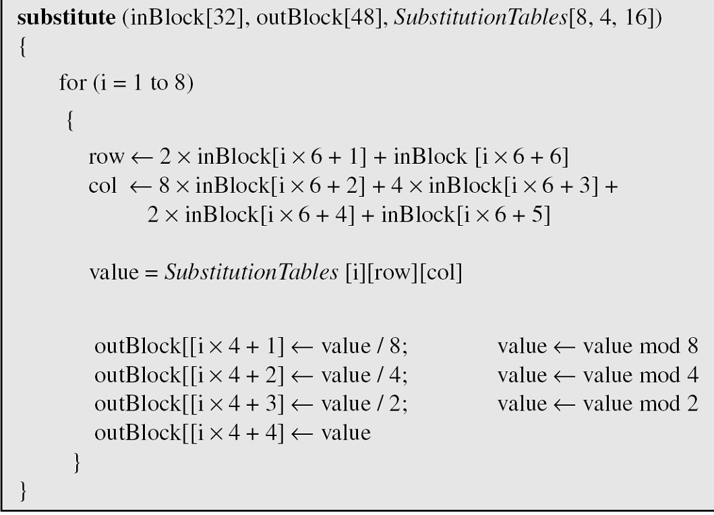
Lecture 5: Data Encryption Standard
1. Data Encryption Standard
2…
3…
2.1 DES Encryption: Feistel Function (DES Function)
S-box

Slide 25
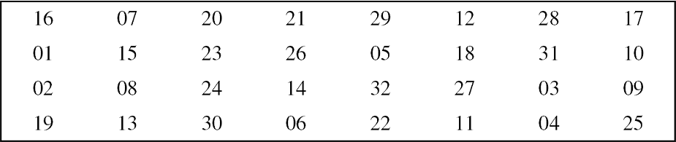
Lecture 5: Data Encryption Standard
1. Data Encryption Standard
2…
3…
2.1 DES Encryption: Feistel Function (DES Function)
S-Pbox
The last operation is Straight Permutation with a P-box as follow.

Slide 26
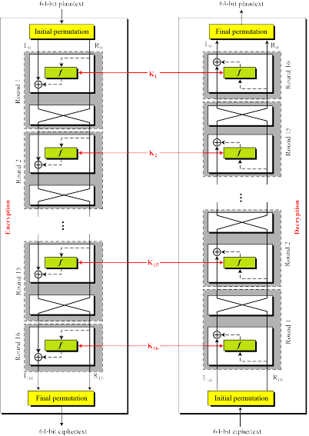
Lecture 5: Data Encryption Standard
1. Data Encryption Standard
2…
3…
2.2 DES Decryption:
The same algorithm as encryption
Use K₁->K₁₆ as encryption, but k₁₆->K₁ as decryption

Slide 27
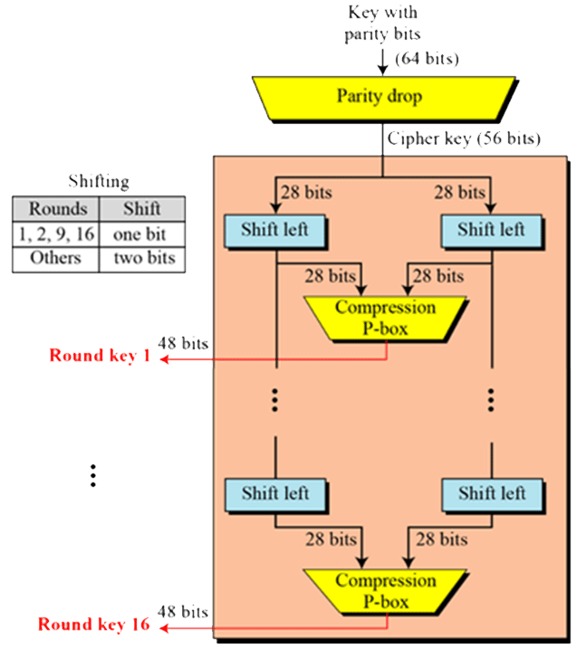
Lecture 5: Data Encryption Standard
1. Data Encryption Standard
2…
3…
2.3 Key Generation and Expansion(扩展)
64bits Random Number
Drop 8bits and permutated to 56bits Key
The round-key generator creates sixteen 48-bit keys out of a 56-bit cipher key.
Expand 16 sub-keys
split 56bits to 2 halves
shift each half
combine them
do compress permutation to 48 bits round-key

Slide 28
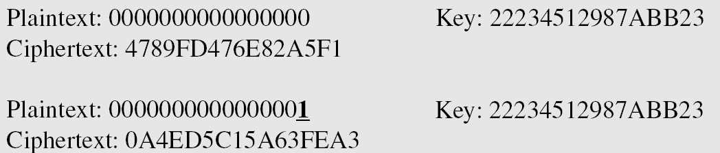
Lecture 5: Data Encryption Standard
1…
2. Security of DES
3…
Avalanche Effect(雪崩效应)
Example: to check the avalanche effect in DES, let us encrypt two plaintext blocks (with the same key) that differ only in one bit and observe the differences in the number of bits in each round.
Although the two plaintext blocks differ only in the rightmost bit, the ciphertext blocks differ in 29 bits. This means that changing approximately(大约) 1.5 percent of the plaintext creates a change of approximately 45 percent in the ciphertext.

Slide 29
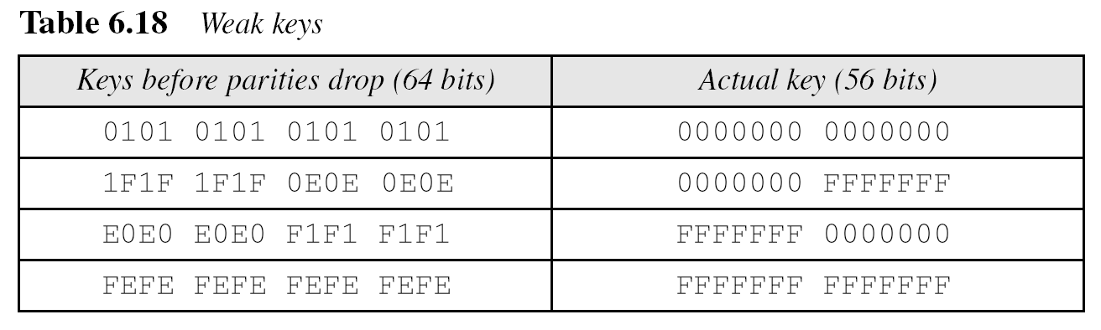
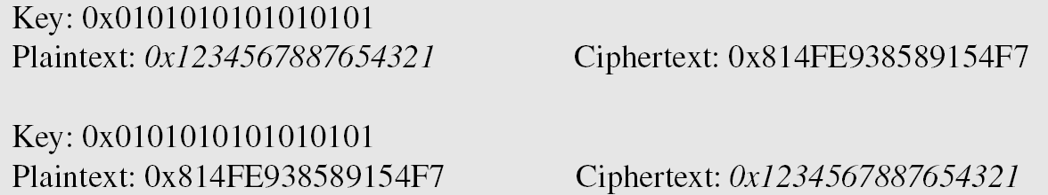
Lecture 5: Data Encryption Standard
1…
2. Security of DES
3…
DES weakness
During the last few years critics(评论家) have found some weaknesses(弱点) in DES.
1. Weaknesses in S-boxes
2. Weaknesses in P-boxes
3. Weaknesses in Key

Slide 30
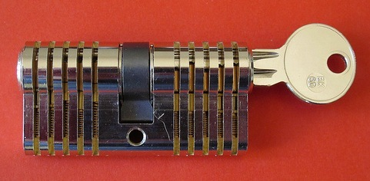
Lecture 5: Data Encryption Standard
1…
2. Security of DES
3…
Key Size
56-bit keys have 2⁵⁶ = 7.2 x 10¹⁶ values
brute force search looks hard
recent advances have shown is possible
in 1997, on Internet in a few months
in 1998, in a few days
in 1999 above combined in 22hrs!
still must be able to recognize plaintext
must consider alternatives(替代物) to DES

Slide 31
Lecture 5: Data Encryption Standard
1…
2. Security of DES
3…
Cryptanalysis on DES
generally these are statistical(统计的) attacks include
differential cryptanalysis(微分密码分析)
linear cryptanalysis(线性密码分析)
related key attacks

Slide 32
Lecture 5: Data Encryption Standard
1…
2…
3. Multiple Encryption and 3-DES
Why Multiple Encryption?
alternatives to DES
expand key size
K1
K2
DES
DES
Plaintext
Midtext
Ciphertext

Slide 33
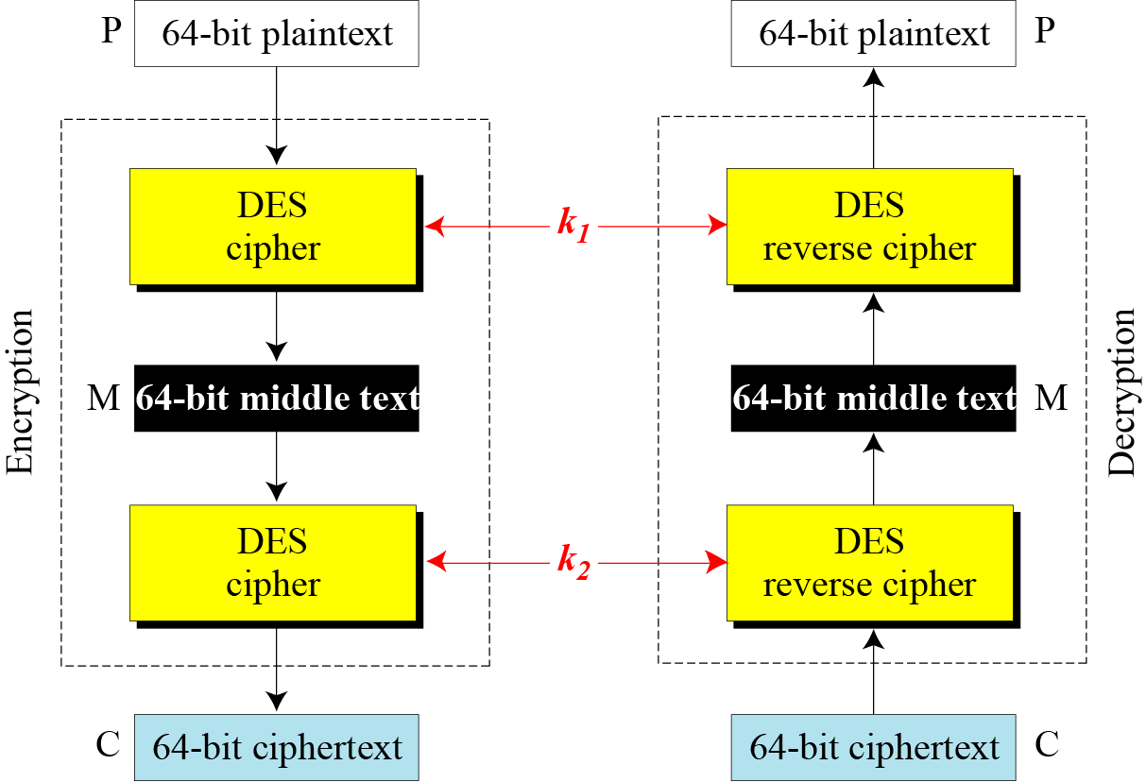
Lecture 5: Data Encryption Standard
1…
2…
3. Multiple Encryption and 3-DES
Double DES
C = E_{K2}(E_{K1}(P))
P = D_{K1}(D_{K2}(C))
C = D_{K2}(E_{K1}(P))
P = D_{K1}(E_{K2}(C))
Meet-in-the-middle attack:

Slide 34
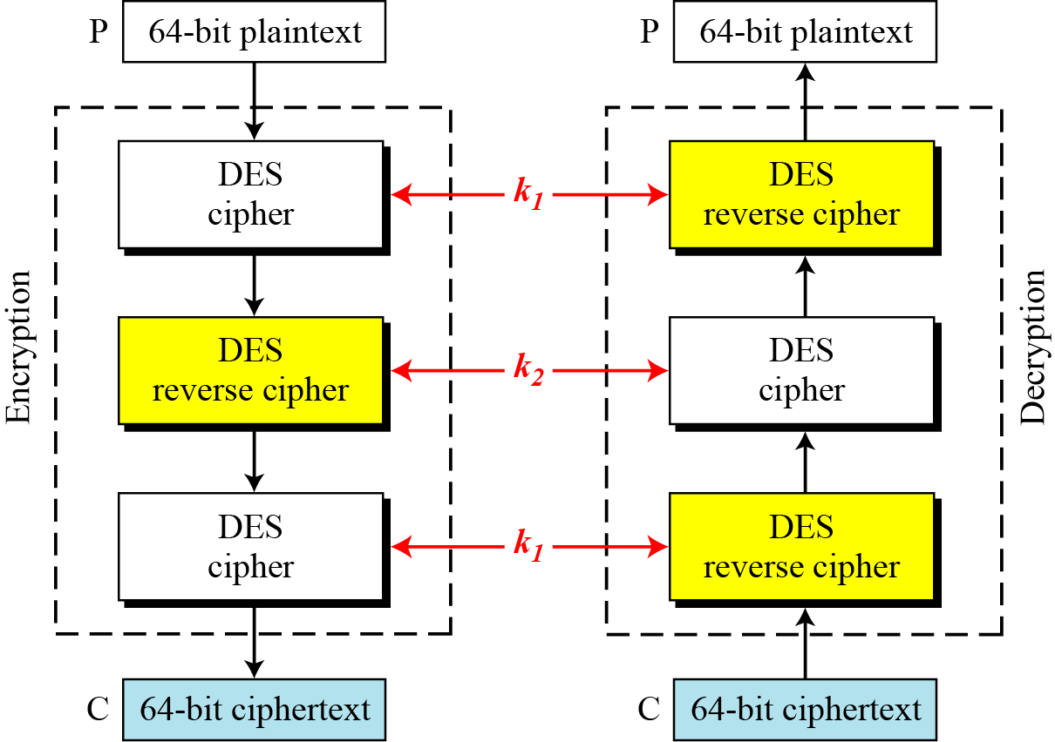
Lecture 5: Data Encryption Standard
1…
2…
3. Multiple Encryption and 3-DES
Triple DES
Triple DES with 2 keys
C=E_{k1}(D_{k2}(E_{k1}(P)))
P=D_{k1}(E_{k2}(D_{k1}(C)))
K1+K2: 112bits
Triple DES with 3 keys
C=E_{k3}(D_{k2}(E_{k1}(P)))
P=D_{k1}(E_{k2}(D_{k3}(C)))
More secure than DES, but with more cost

Slide 35
Lecture 5: Data Encryption Standard
Summary
Data Encryption Standard (DES)
DES Encryption
DES Decryption
Key Generation and expansion(密钥扩展)
Strength of DES
Multiple Encryption and 3-DES

Slide 36
An Introduction to Information Security
Thanks for your attention!
Q&A

